Slide 1
Agenda for today
The landscape of hypothesis testing
A few real world problems on hypothesis testing
A bit more on test vs. control
Testing distributions and a few real world problems on similarity
Type-1 and Type-2 errors and cost of errors
Design of experiments
A good meeting starts with a clear agenda

Slide 2
What do you want to test today?
Testing for quantitative data
Test variance
Test mean
Anderson Darling Test for normality
Anderson Darling Test for normality or leverage central limit theorem to calculate standard error
Non-normal data: Levene’s test
Normal data: for two samples use F-test
Normal data: for more than two samples use Bartlett’s test
Single sample: use one sample t-test
Paired two sample: Paired t-test
Test equality of variance
Non paired two sample: Two sample t-test for equal variance
Non paired two sample: Two sample t-test for unequal variance
More than two sample: equal variance use ANOVA
More than two sample: un-equal variance use ANOVA and ANCOVA (explore Welch approach or Bayesian ANOVA)
Identify the right test to make the right inference

Slide 3
What do you want to test today?
Testing for quantitative data
Test Median
One sample
Two sample
More than two sample
Symmetrical distribution
Wilcoxon Test
Asymmetrical distribution
Sing Test
Paired sample: use Friedman Test
Non paired sample: equal variance Mann-Whitney Test
Non paired sample: unequal variance or more than 2 samples use Moods Median, Kruskall Wallis
Identify the right test to make the right inference

Slide 4
Welcome to the real world
Test Vs. Control analysis: the most common use of hypothesis testing
  As a retailer you have the mobile number of all your loyalty customers. You send an offer for 5% price off during festive season. And you see a huge surge in sale. Is the surge due to your discount or due to the season?
Impact assessment without control
  You are a credit card company and you have a promotion on restaurant tables for a 10% off. How do you know that customers are taking out your credit card due to the offer?
  You have a promotion depicting a celebrity in your store and you see a surge in sale before and after the promotion. How do you know that the surge is due to the celebrity and not a natural process?
Sampling
  You have to design a survey and most of the answers are Y/N. How many samples should you use to have a robust measure
  You have selected a sample from the population for a survey, how do you know the sample is representative
An understanding of the problem helps one identify the right test to use

Slide 5
Test Vs. Control
How to look at test vs. control results?
Pre – Post
Test - Control
Treatment
Test
Control
Pre period
Post period
Hypothesis: Pre test = Pre control
Hypothesis: Post test – Post control
Hypothess: (Post test – Pre test) – (Post control – Pre control)
An understanding of the problem helps one identify the right test to use

Slide 6
What do you want to test today?
How to test the similarity between two distributions
  Kolgromove Smirnov Test
  Test median: Mann-Whitney
  Test only correlation between variables and not exactly the distribution: Spearman's rho and Kendall's tau
  Dice and Jaccard similarity indices for 1/0 type of data
  Cosine similarity
  Chi-Square test
  Shapiro-Wilk (testing with respect to normal distribution)
What about qualitative data?
  Chi square test and contingency tables
  Test of proportion
  Similarity measures: cosine similarity
  Rank correlation
Identify the right test to make the right inference

Slide 7
Welcome to the real world
Similarity
  Recommender systems – which users are similar?
    Sridhar: Science Fiction: 10, Horror: 5, Romantic: 3
    Shanti: Science Fiction: 4, Horror: 1, Romantic: 2
    Senthil: Science Fiction: 1, Horror: 3, Romantic: 6
  Multi dimensional scaling – which of the brands are closest?
    Suzuki: price (750), mileage (200), servicing(320), space(276), looks(310), power (118)
    Hyundai: price(126), looks,(278) power(312), mileage (187), space (236), servicing (112), noise (78)
    Nissan: looks(112), power(189), space(286), noise(374), mileage(112), servicing (126), price(117)
    Toyota: looks(118), power (128), space(326), mileage(189), noise(116), price(89)
  Identification of faulty patterns in signals
    Healthcare data pattern
    Machine data pattern
  Identification of distribution
An understanding of the problem helps one identify the right test to use

Slide 8
“There are more things in heaven and earth…..”
In reality the null hypothesis is true
In reality the null hypothesis is false
If we test a hypothesis multiple times, the chance of an error increases with each test
What do we do?
  The Bonferroni correction sets the significance cut-off at α/n
  For example, in the example above, with 20 tests and α = 0.05, you’d only reject a null hypothesis if the p-value is less than 0.0025
Correct decision
1- Alpha
Incorrect decision
Beta
Do not reject the null hypothesis
Incorrect decision
Alpha
Correct decision
1-Beta
Reject the null hypothesis
Power of a test = 1 - Beta
How do we determine the significance of a test?

Slide 9
How do we determine alpha and beta?
Cost of an error determines the significance
Impact of inaccurate prediction vs. false positive
Examples
  Hypothesis: If a person spends more than Rs. 5,000 on gym membership then we conclude that his/her income is more than Rs. 25 Lacs. And we send a free copy of a magazine to him/her along with an advertisement of the company’s luxury spa service. What are the costs of the errors? And should we have high alpha or low alpha
  Hypothesis: If the exhaust temperature of a car engine exceeds 200 degree centigrade then we infer that there is a problem and we send an SMS to the driver to come and visit the service station. What are the costs? And should we have high alpha or low alpha
Sensitivity and specificity of a model uses a similar concept
How do we determine the significance of a test?

Slide 10
Design of experiment
Business managers often ask questions like:
  Do our customers love a free gift more than a discount?
  Do our customers respond to advertising that contain the picture of a sports icon?
How can we answer these questions?
  Simple: “ask the customer”
  But how do you ask if there are so many things to ask
The process of “asking the customer” entails creating experiments or tests where one is able to read the result and obtain answers to the questions of interest
Most companies set aside a testing budget that would allow them to test and learn
As the budget is always limited, it is never possible to test all combinations of every marketing parameter
Build a testing framework which helps them in identifying the critical few learning
How to know about the customer – simple ask them

Slide 11
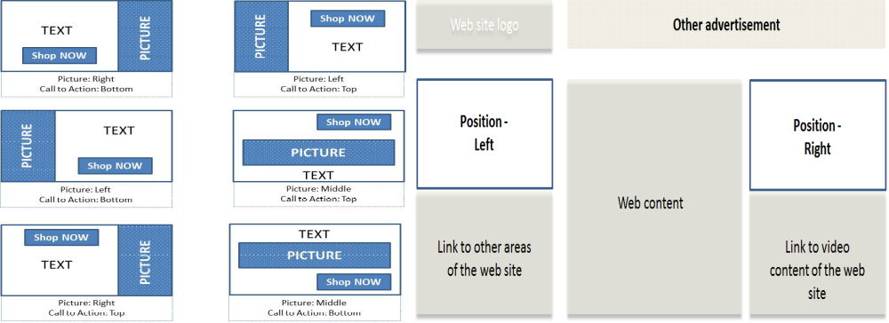
DoE: a simple example
A simple example of a banner Ad:
  A picture
  A text message about the offer and product
  A redirect link(which takes to the landing page of advertiser). This is ‘Call to Action’ Link.
Parameters to experiment (or factors)
  Position of the picture: Left, Right, Middle
  Position of the Call to Action link: Top and Bottom
  Presence of animation or movement in the picture: Yes, No
  Position of the banner advertisement on the web page: Left and Right
  There will be 3*2*2*2 = 24 combinations that one could have
How to know about the customer – simple ask them

Slide 12
DoE: without interaction
It is important to quantify the “success metric” for a banner advertisement
The most common success metric that is used is called the Click Through Rate (CTR)
Click through rate is a very simple metric which is calculated as: Number of visitors clicking the link in the advertisement divided by the number of visitors who are exposed to the advertisement.
Assuming that CTR can be modeled as a logistic regression
Ln(CTR/(1-CTR)) = α + β1(Position of picture is left)
+ β2(Position of picture is right)
+ β3(Position of call to action link is top)
+ β4(Presence of animation is yes) 4
+ β5(Placement on web site is left)
How to know about the customer – simple ask them

Slide 13
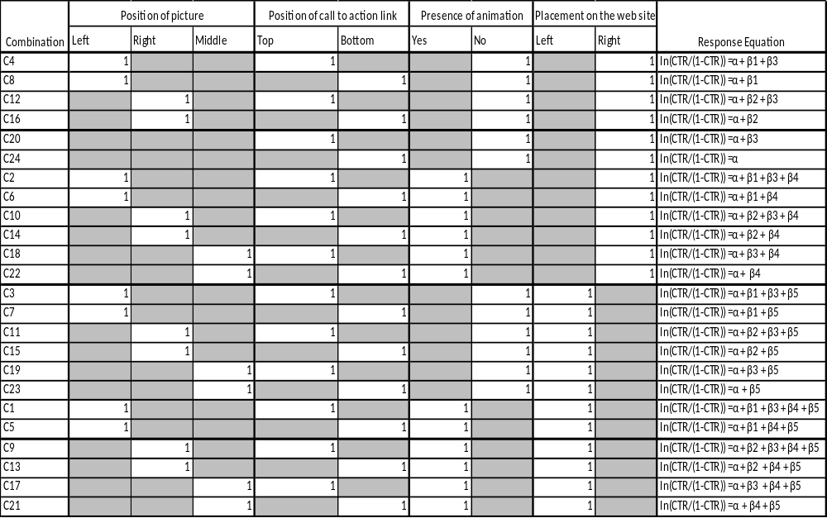
DoE: without interaction effects
How to know about the customer – simple ask them

Slide 14
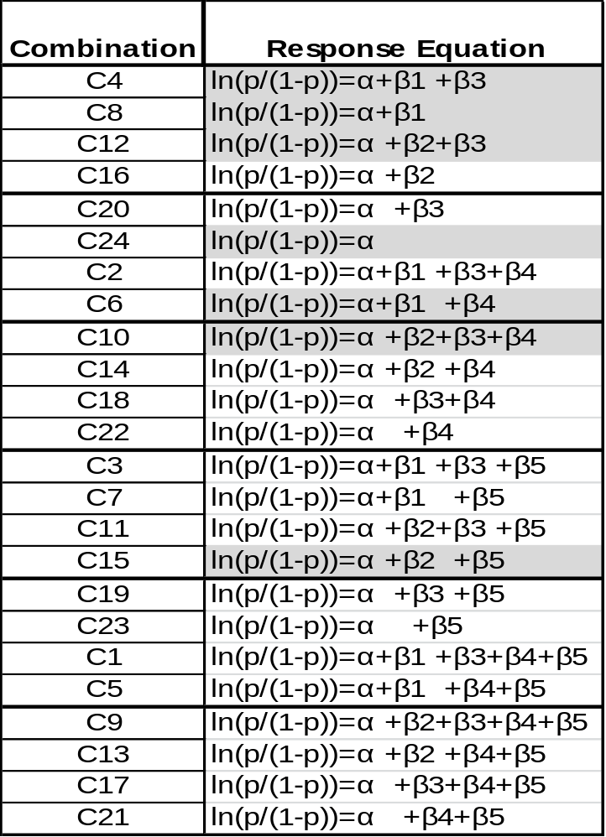
DoE: without interaction effects
Partial factorial design
Estimating α: If one has results of experiment C24 one will be able to ascertain the value of α
Estimating β3: If one has the results of C4 and C8 then one can obtain the value of β3.
Estimating β2: If one has the results of experiment C12 then one can plug in the values of α and β3 to obtain β2
Estimating β4: If one has the result of C10 one could use the values of α β2 and β3 to obtain β4
Estimating β1: The value of β4 can then be plugged into the result of C6 to obtain β1
Estimating β5: The value of β5 can be obtained by plugging in the value of β2 into the result of experiment C15
By conducting only 7 experiments (C4, C8, C12, C14, C6, C10 and C15), one can obtain all the information that can be obtained by conducting 24 experiments.
How to know about the customer – simple ask them

Slide 15
DoE: with interaction effects
As a critic of the partial factorial approach, one could argue that the combination of an animation and a placement of the advertisement to the right of the website would be more effective in conjunction
This implies that the interaction between placement and animation needs to be taken into account
It is difficult to limit the number of experiments or tests that needs to be conducted if there are significant number of interactions
Ln(CTR/(1-CTR)) = α + β1(Position of picture is left)
+ β2(Position of picture is right)
+ β3(Position of call to action link is top)
+ β4(Presence of animation is yes)
+ β5(Placement on web site is left)
+ β10(Placement on web site is left & Presence of animation)
How to know about the customer – simple ask them

